Slide 1
Supply Chain Management Analysis
“An In-Depth Analysis of Key Supply Chain Metrics and Optimization Opportunities”

Slide 2

Objective
The goal of this analysis is to assess product performance and supply chain efficiency. By looking at stock levels, lead times, shipping costs, and supplier performance, we aim to identify top-performing products and find ways to optimize operations, reduce costs, and improve product availability.
Key Business Questions
Product Performance:
What are the number of product sold for each product type.
Show the distribution of price for different product type.
What are the stock levels across different product type.
Supply Chain Efficiency:
Find relationship between lead times and order quantities across different supplier name.
Find shipping cost per shipping carrier filter by location to see regional differences.
Show defect rates by supplier name or location.
Customer Demographics:
Create a demographic distribution chart to show the breakdown of customers by other demographics.
Show revenue generated by customer demographics.

Slide 3

Dataset Overview
This dataset focuses on the supply chain of cosmetic products, capturing essential details that impact performance and efficiency. Key columns include product type, SKU, price, stock levels, order quantities, shipping times, and supplier information. This data enables analysis of inventory management, supplier reliability, shipping efficiency, and costs, helping us gain insights into the cosmetics supply chain.
Key Columns:
Product Type: Categorizes the cosmetic products, allowing us to analyze performance by product category.
SKU: Unique identifier for each product, useful for tracking inventory and sales.
Price: The selling price of each product, important for revenue calculations and profitability analysis.
Availability: Indicates if a product is in stock, helping to assess inventory levels and potential stockouts.
Order Quantities: Shows the volume of each product ordered, which helps in understanding demand patterns.
Shipping Times: Time taken for products to reach customers, providing insights into shipping efficiency.
Supplier Name: Identifies the supplier for each product, helping to evaluate supplier performance and reliability.
Lead Time: The time required to restock or produce items, essential for managing inventory and avoiding delays.
Manufacturing Costs: Cost incurred to produce each product, critical for profitability and cost analysis.
Defect Rates: The rate of product defects, which highlights quality control issues in the supply chain.

Slide 4
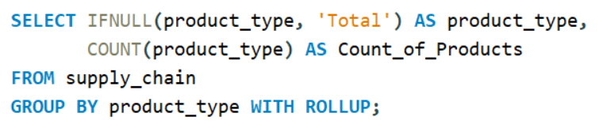
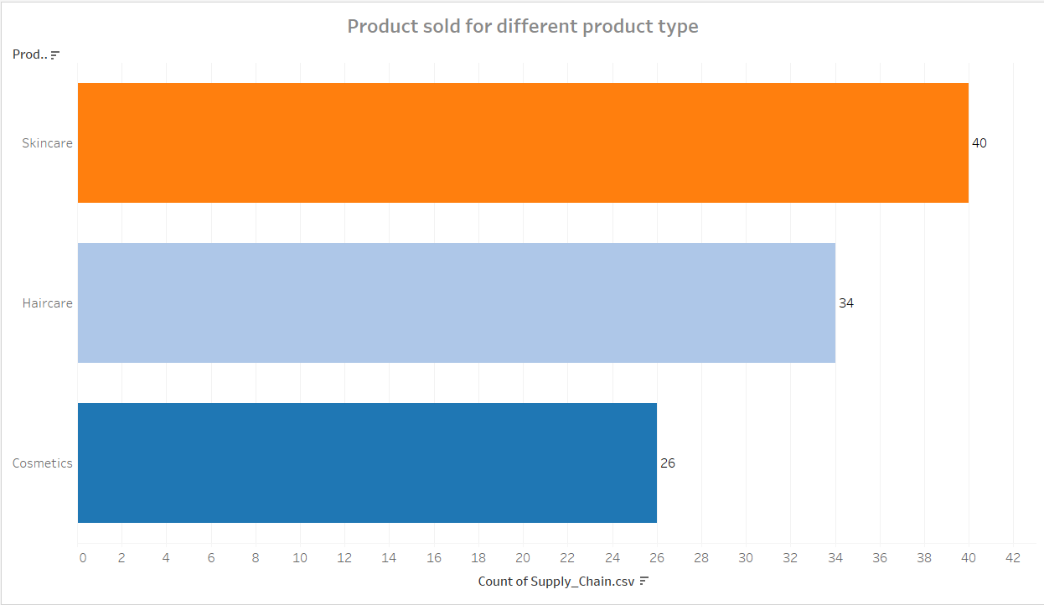
Number of product sold for each product type
In the given bar graph it is clear that Skincare and Haircare products have higher sales.
Analysis
Skincare products have the highest sales count which indicates a stronger demand or availability within this category.
Haircare products have slightly lower numbers compared to skincare.
Cosmetics products have the lowest sales count suggesting either lower demand, fewer offerings.
Focus area
Increasing focus on Skincare products may capitalize on its popularity.
Exploring opportunities to boost sales for Cosmetics might help create a more balanced product distribution across categories.

Slide 5
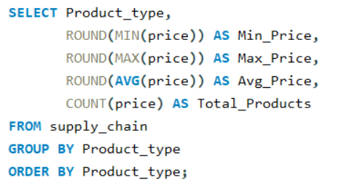
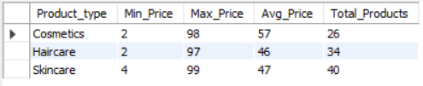
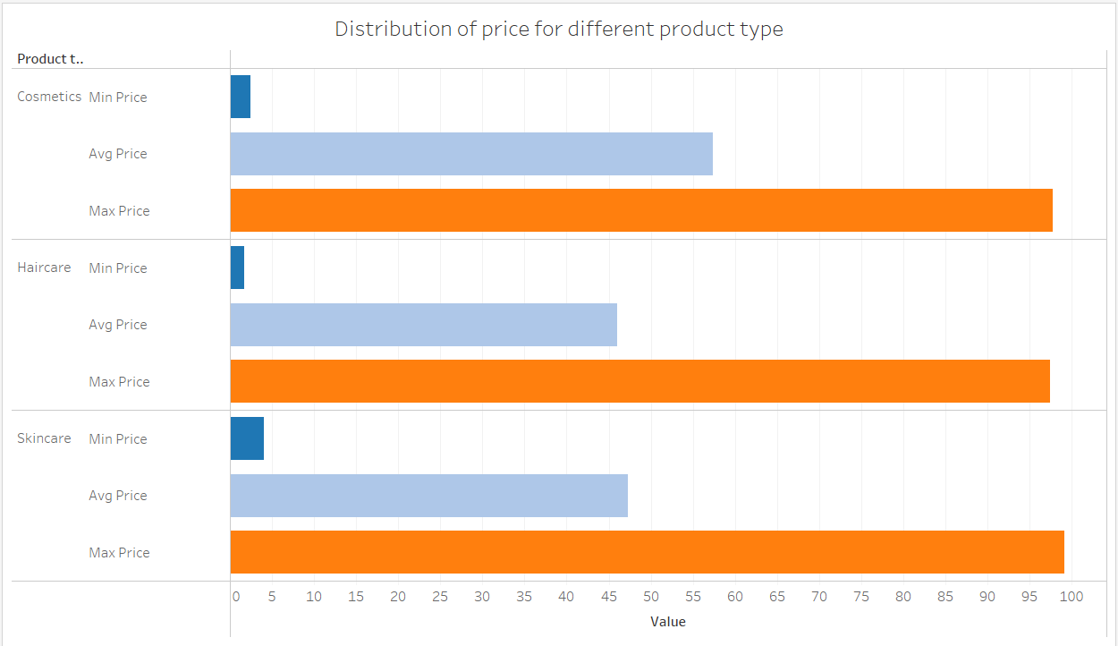
Distribution of price for different product type
The chart compares the minimum, average, and maximum prices across different product types Cosmetics, Haircare, and Skincare.
Insights
All three categories have high maximum prices, indicating premium products are available across all types.
Cosmetics and Haircare have similar pricing distributions with lower minimum and average prices compared to Skincare. This signifies that Skincare products are positioned as higher-end or more valuable.
Potential Focus
If the goal is to increase sales the focus should be on expanding the lower and mid-range price options in Cosmetics and Skincare given that its average price is relatively high which could limit accessibility for price-sensitive customers.

Slide 6
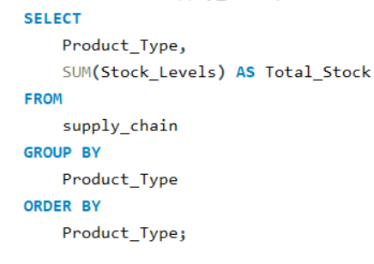
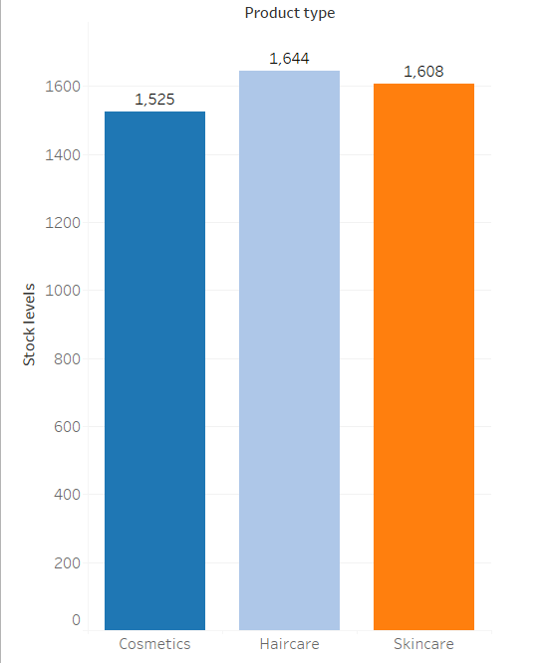
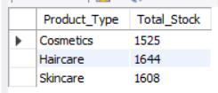
Stock levels across different Product type
Insights
Balanced Inventory : There are slight differences in stock levels they are relatively similar across all three product types suggesting that the inventory management have a balanced stock level for each category.
Higher Sales / Premium Pricing : The higher stock level for Haircare could indicate a higher demand or expectation of more frequent purchases, while Skincare's high stock level may reflect its potential premium pricing strategy or expected popularity.
Potential Focus
For Inventory Planning: Keep a close watch on the sales rate of each product type. If Haircare products are sold at a faster rate the higher stock level is justified. Otherwise consider reallocating stock based on actual demand.
Monitor Skincare Demand: With a high stock level and a higher average price it’s essential to ensure that there’s enough demand for Skincare to prevent overstocking as excess inventory in this category could tie up resources.

Slide 7
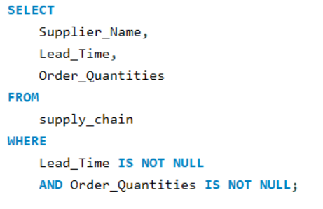
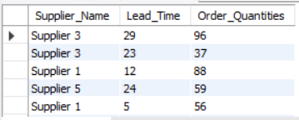
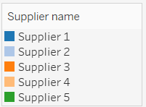
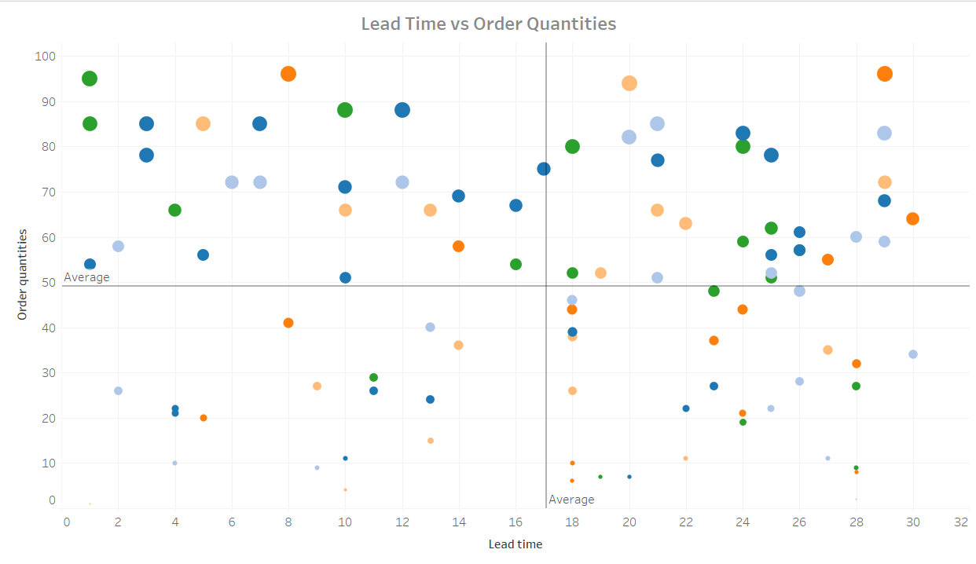
Relationship between lead time and order quantities across different supplier
There doesn't appear to be a clear linear relationship between lead time and order quantities, as the points are fairly scattered. This suggests that lead time may not directly influence the quantity ordered.
Insights
Top Left Quadrant: High order quantities with shorter lead times indicating fast-moving products that are frequently ordered in large amounts also suggests these are Most efficient suppliers.
Top Right Quadrant: High order quantities with longer lead times which could suggest planned bulk orders for slower-moving products or products with longer production schedules there are also Efficient suppliers.
Bottom Left Quadrant: Low order quantities with shorter lead times shows less quantities will require lesser time so the supplier in this quadrant are Efficient in supplying lower quantities.
Bottom Right Quadrant: Low order quantities with longer lead times, potentially indicating low-demand items or items that require more careful planning and also very less Efficient suppliers.
Potential Focus
Optimize Inventory for High Demand: For items that consistently fall in the higher order quantities (top two quadrants) consider stocking more of these products to avoid shortages.
Review Supply Chain Efficiency: For products with high order quantities and long lead times investigate if there are opportunities to shorten lead times especially if the demand is frequent and predictable.

Slide 8
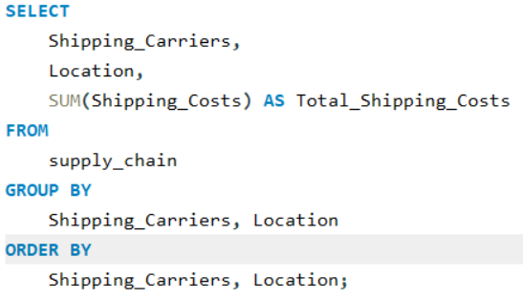
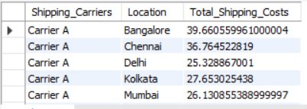
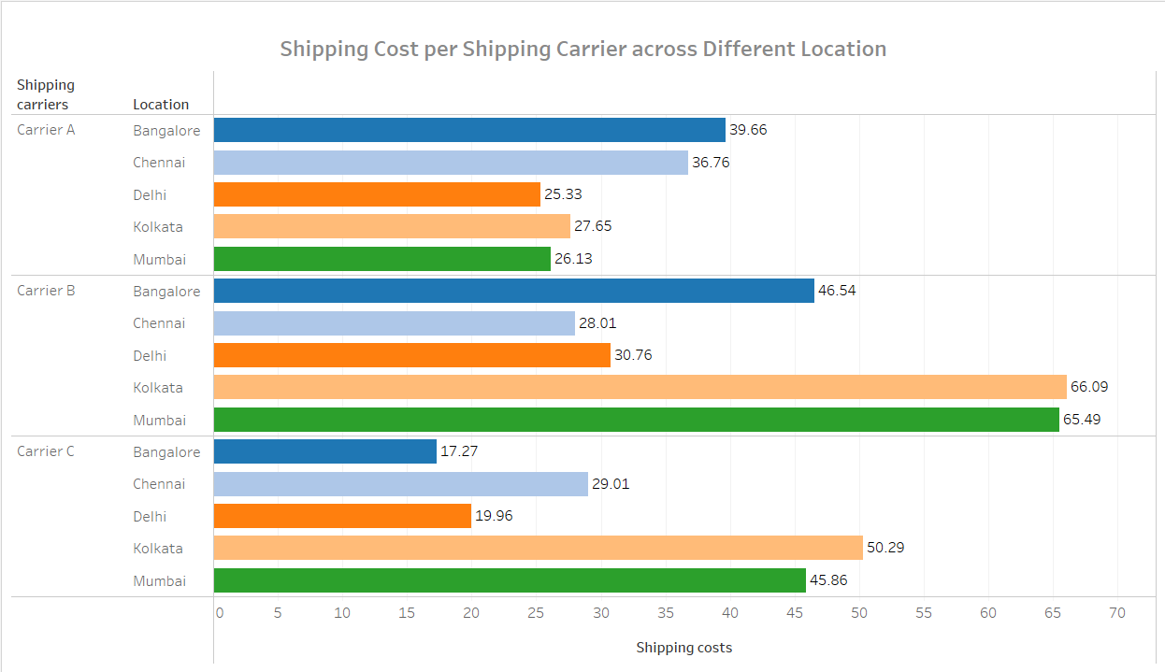
Shipping Cost Per Shipping Carrier
Insights
Carrier C appears to be the most cost-effective option across multiple locations especially in Bangalore, Delhi, and Mumbai. This may make Carrier C a preferred choice for companies aiming to minimize shipping expenses.
Carrier B seems to be the most expensive across most locations, particularly in Kolkata and Mumbai, which could be due to higher service levels, priority handling, or additional regional fees.
Potential Focus
Optimize Shipping Carrier Selection: For each location consider choosing the carrier with the lowest cost to minimize expenses. For example, Carrier C for Delhi and Bangalore and Carrier A for Kolkata and Mumbai.
Evaluate Carrier B’s Cost Justification: If Carrier B’s higher costs come with added value, such as faster shipping or better tracking, that may justify the price otherwise lower-cost carriers like A or C might be preferable.

Slide 9
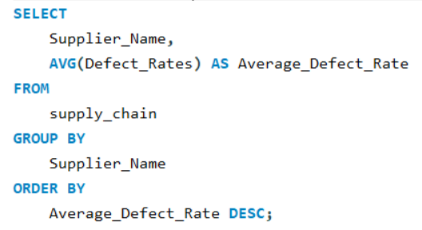
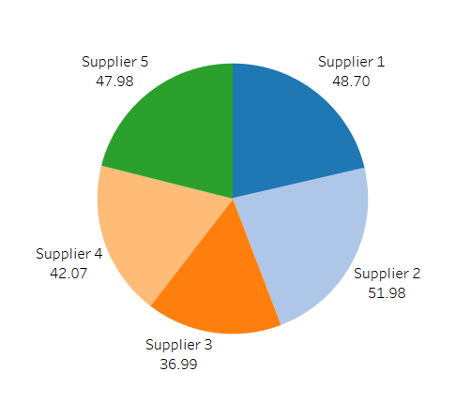
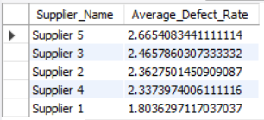
Defect Rates by Supplier Name
Insights
Highest Defect Rate Supplier : Supplier 2 has highest defect rates (51.98)
Lowest Defect Rate Supplier: Supplier 3 has lowest defect rate(36.99)

Slide 10
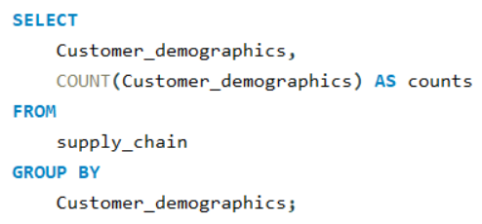
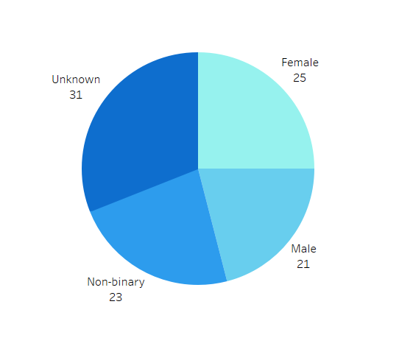
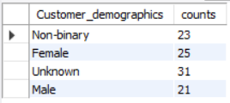
Breakdown of Customer Demographics
Insights
Highest Customer Segment: The highest customer segment is unknown which is they may include all genders.
Lowest Customer Segment: The lowest customer segment is Non-binary and Males which signifies that user the products are mostly female.

Slide 11
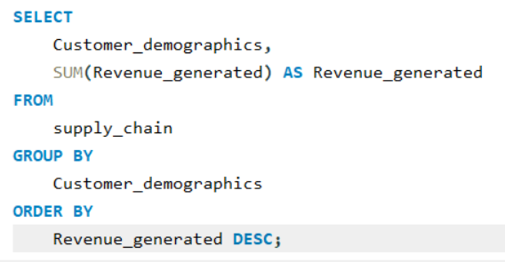
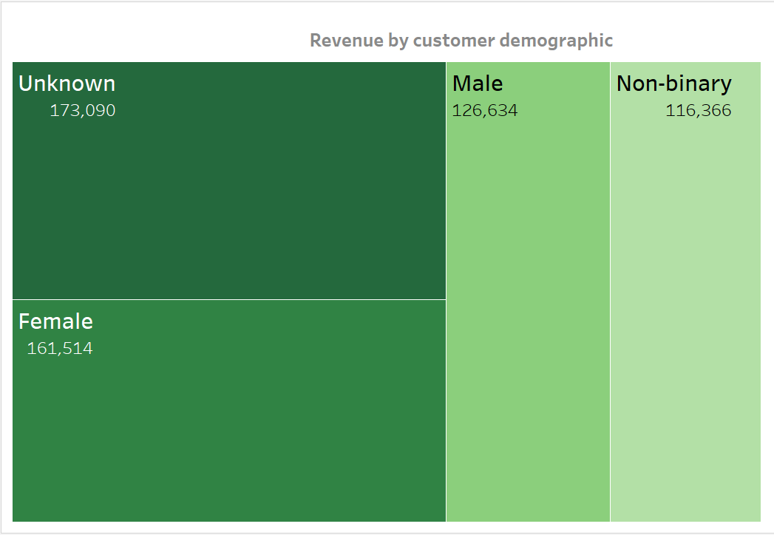
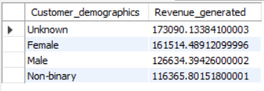
Revenue Generated by Customer Demographics
Insights
The Higher Revenue has come from Unknown customers which is it can include all the genders.
The Second Highest Revenue has come from females which suggests that the skincare and haircare products have more demand.

Slide 12
Recommendation
Optimize Supplier Quality Management :Develop quality improvement plans with high-defect suppliers or consider shifting more purchases to reliable suppliers with lower defect rates. Regularly monitor supplier performance to ensure consistent quality.
Strategically Choose Shipping Carriers by Location: Use data-driven carrier assignments to reduce shipping costs and negotiate better rates with carriers especially for high-cost routes.
Reduce Lead Times for Cost-Effective Operation: Negotiate with carriers for faster delivery options or consider local suppliers for products with high demand especially in metro regions like Delhi and Mumbai.
Focus on High-Revenue Customer Demographics: Create targeted promotions, personalized offers, and loyalty programs to engage these high-revenue customers further, potentially increasing their lifetime value.
Optimize Shipping Carrier Contracts Based on Cost Analysis: Establish contracts that leverage volume discounts for frequently used routes and locations with higher costs helping to reduce overall shipping expenses

Slide 13
Summary
This supply chain analysis reveals key opportunities to optimize costs enhance quality and improve customer satisfaction. Shipping costs vary significantly across carriers and locations suggesting potential savings by prioritizing more cost-effective carriers or renegotiating with high-cost providers. Supplier quality is also an area of concern as some suppliers have higher defect rates focusing on quality improvements or switching to more reliable suppliers can help ensure consistency. Additionally revenue analysis shows that certain customer demographics contribute more significantly indicating that targeted marketing efforts toward these segments could increase revenue. Shortening lead times especially for high-demand regions could further improve operational efficiency and boost customer satisfaction. By continuously monitoring these areas the supply chain can be strengthened to meet both financial and service-level goals.

Slide 14
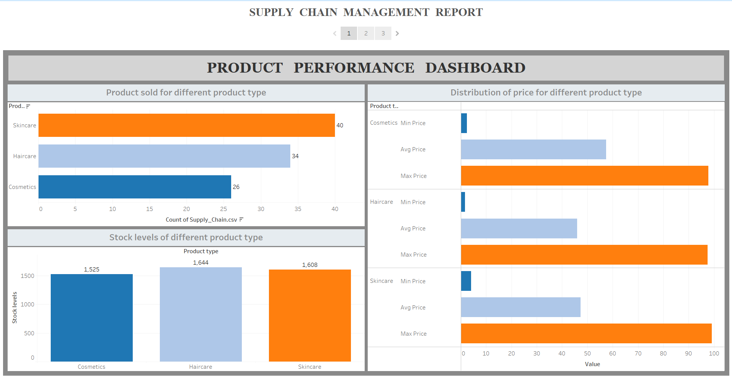

Slide 15
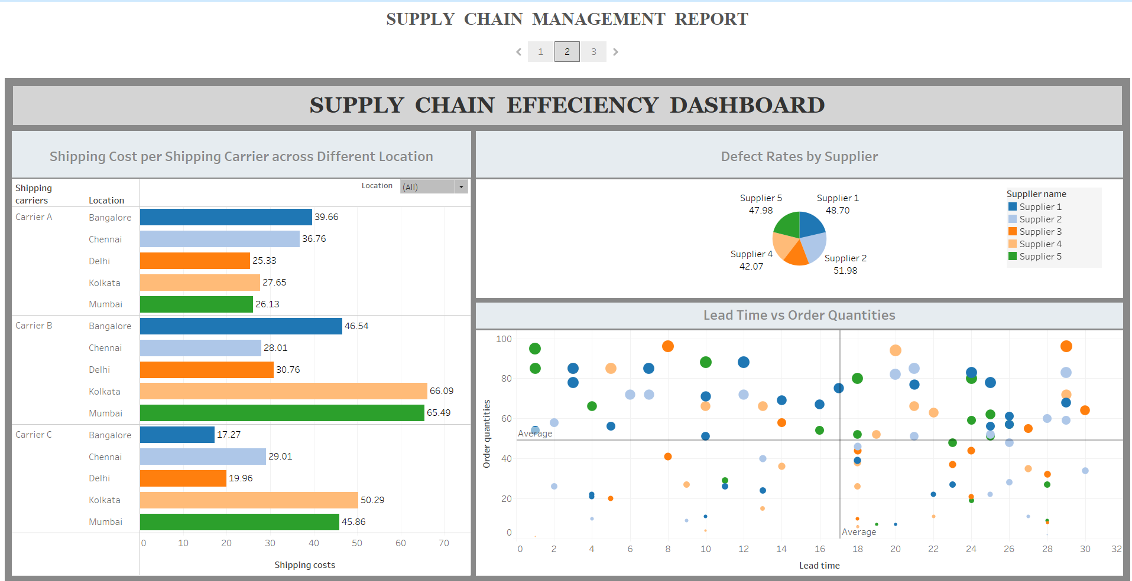

Slide 16
